Slide 1

Risk Modeling of Lung Cancer Likelihood Based on Lifestyle and Health Factors
TANMOY SAHA TURJA

Slide 2




About Dataset
The dataset was sourced from https://www.kaggle.com/datasets/akashnath29/lung-cancer-dataset
The Title of the Dataset is “Lung Cancer Dataset”
The dataset contains survey responses related to lung cancer symptoms and lifestyle habits.
Key Variables: LUNG_CANCER: Indicates whether the individual has lung cancer or not
AGE: Age of the individual
SMOKING, ALCOHOL_CONSUMING, CHRONIC_DISEASE: Lifestyle factors
COUGHING, CHEST_PAIN, WHEEZING, SHORTNESS_OF_BREATH: Symptom indicators
PEER_PRESSURE, YELLOW_FINGERS: Additional behavior markers
Notes:
This analysis will be performed using a dataset sourced from kaggle.com
The Title of the Dataset is “Lung Cancer Dataset”
The dataset contains survey responses related to lung cancer symptoms and lifestyle habits.
The key variables indicate if the person surveyed is diagnosed with lung cancer, age of the individual, some lifestyle factors, symptom indicators and additional behavior markers.

Slide 3
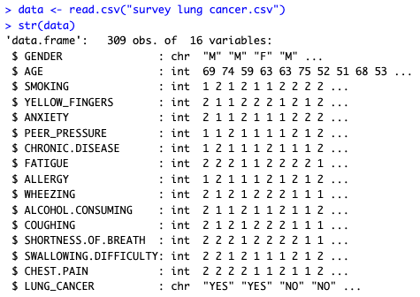
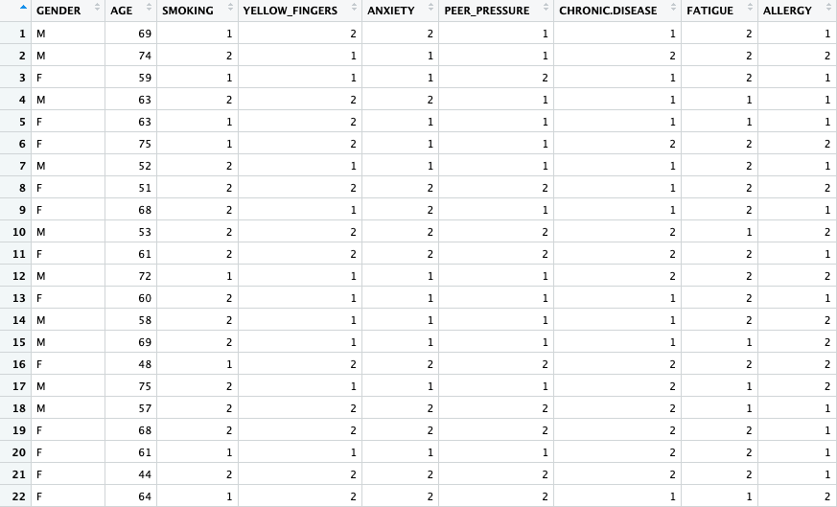
About Dataset
Notes:
The data structure shows that it has 309 observations, and 16 variables.
The Lifestyle factors, Symptom indicators and additional behavioral marks are in integers where the number 2 means “Yes” and 1 means “No”.

Slide 4
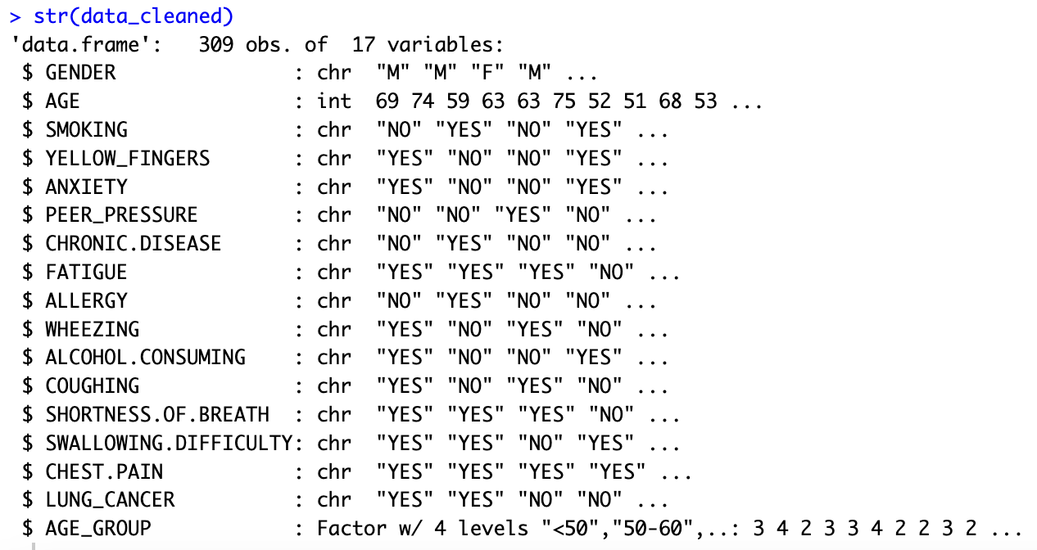
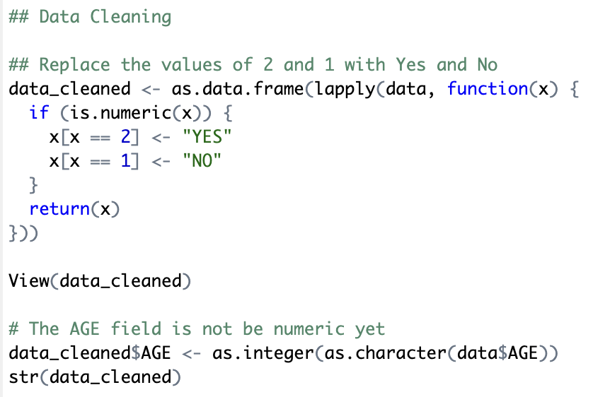
Data Cleaning
* I cleaned the dataset using R programing by replacing “2” with “YES” and “1” with “NO” to make the dataset more convenient for analysis
Notes:
Replaced all instances of “1” with “NO” and “2” with “YES”.

Slide 5
Research Questions
The project answered the questions below:
1. What is the overall probability of lung cancer in the surveyed population?
2. How does the probability of lung cancer vary across different age groups?
3. What is the probability of a person being a smoker given that they have lung cancer?
4. Can we estimate the average age of lung cancer diagnosis using a random sample from the dataset?
5. How does the uncertainty in risk factors affect the probability of developing lung cancer?

Slide 6
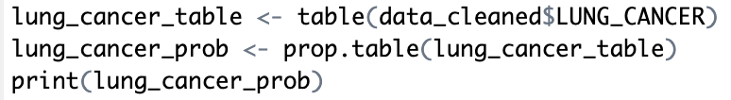
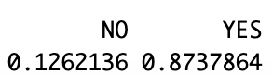
What is the overall probability of lung cancer in the surveyed population?
Code:
Result:
Question 1
Notes:
Calculated the overall probability of lung cancer in the dataset.
The result showed that about 87% of respondents were diagnosed with lung cancer.

Slide 7
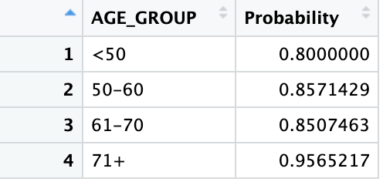
How does the probability of lung cancer vary across different age groups?
Code:
# Create age groups
data_cleaned$AGE_GROUP <- cut(data_cleaned$AGE,
breaks = c(0, 50, 60, 70, Inf),
labels = c("<50", "50-60", "61-70", "71+"),
right = FALSE)
View(data_cleaned)
## Calculate average (probability) of lung cancer in each age group
age_group_prob <- data_cleaned %>%
group_by(AGE_GROUP) %>%
summarise(Probability = sum(LUNG_CANCER == "YES") / n())
View(age_group_prob)
Result:
Question 2
Notes:
Explored how lung cancer probability varies by age.
Divided the population into four age groups: under 50, 50 to 60, 61 to 70, and 71 and above.

Slide 8
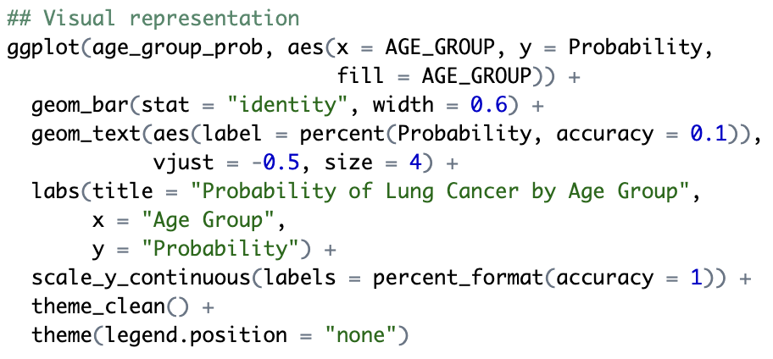
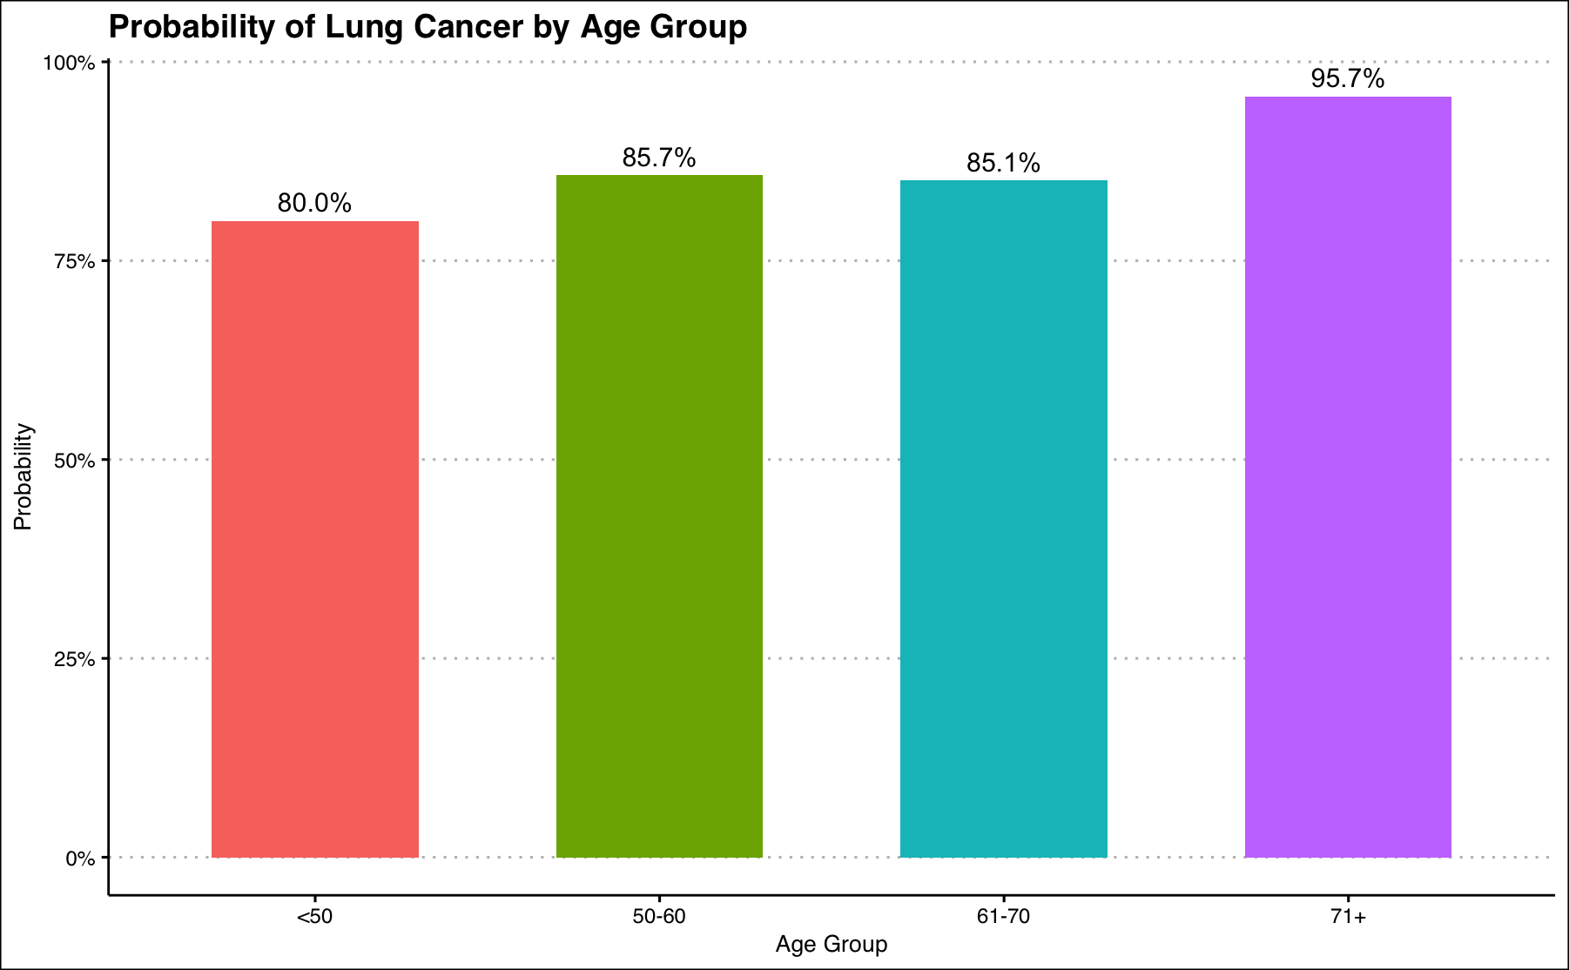
How does the probability of lung cancer vary across different age groups?
Code:
Result:
Question 2
Notes:
This bar chart visually shows the probability of lung cancer across different age groups. It does not add up to 100% because I am Calculating the probability of lung cancer within each age group — not the percentage of lung cancer cases distributed among age groups.

Slide 9
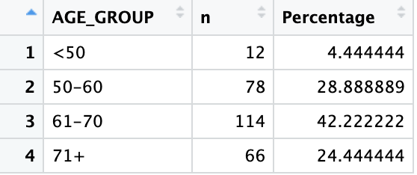
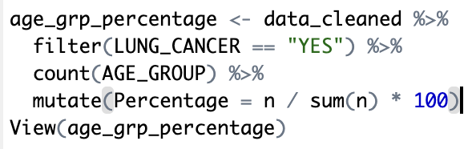
Among all people with lung cancer, how many are from each age group?
Result:
Code:
Follow-up Question 2
Notes:
As a follow-up, I wanted to understand how lung cancer cases are distributed across age groups. This highlights the importance of targeting older adults for screening and awareness efforts.

Slide 10
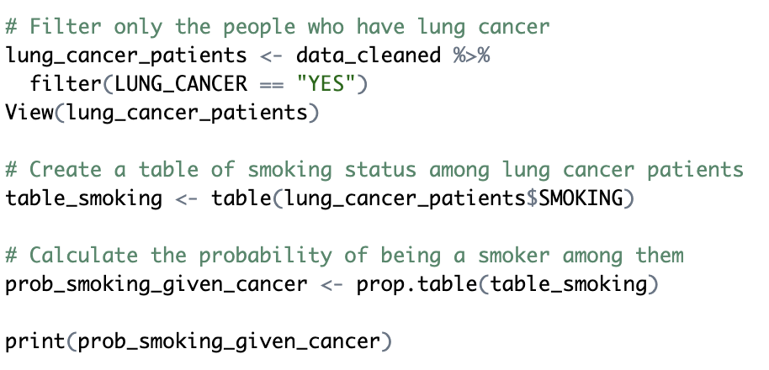

What is the probability of a person being a smoker given that they have lung cancer?
Code:
Result:
Question 3
Notes:
The result was that about 57.4% of lung cancer patients in the dataset were smokers — reinforcing the strong link between smoking and lung cancer.

Slide 11
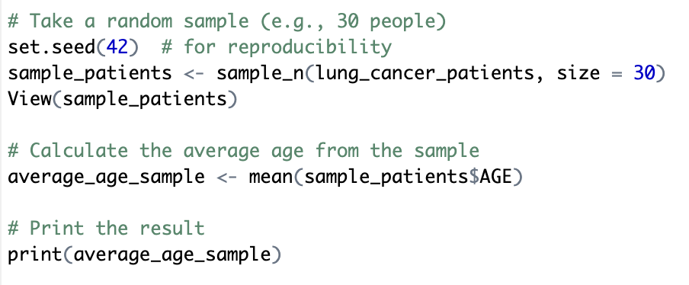

Can we estimate the average age of lung cancer diagnosis using a random sample from the dataset?
Code:
Result:
Question 4
Notes:
Randomly selected 30 patients with lung cancer and found that their average age was approximately 63.6 years — which aligns well with the age group analysis we saw earlier.

Slide 12
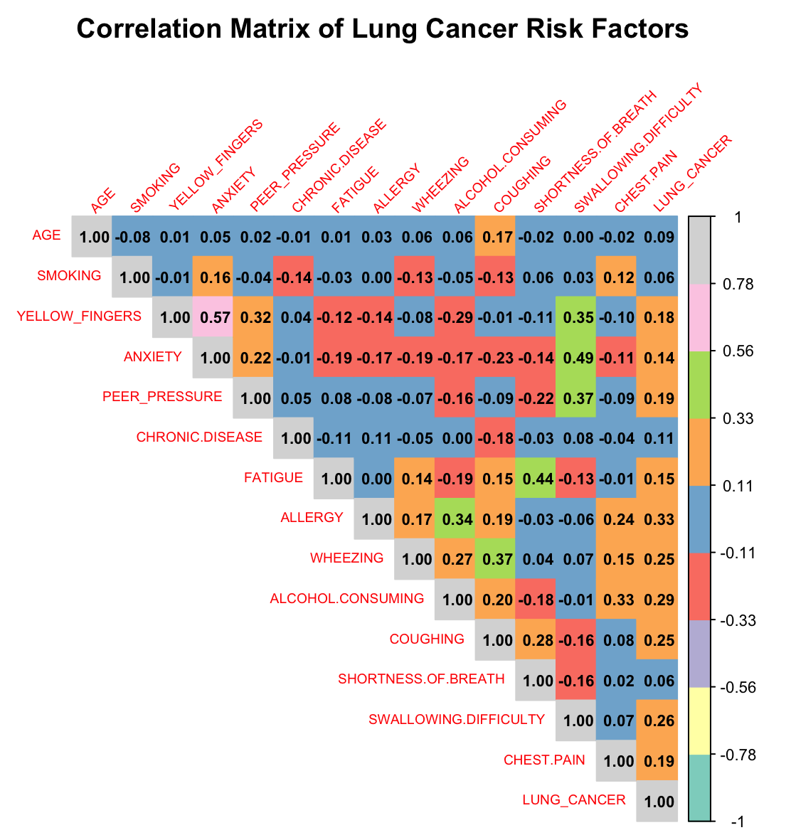
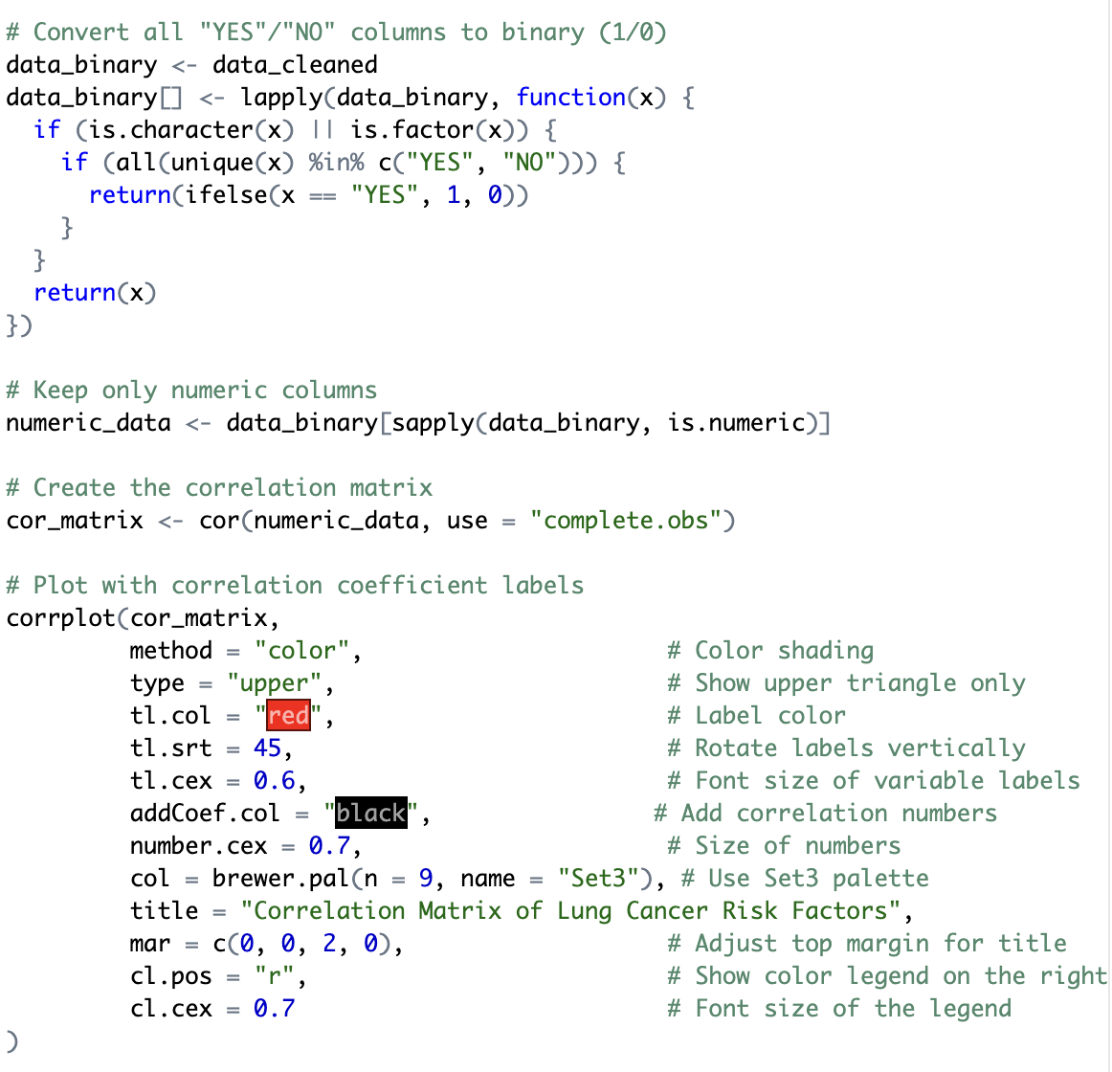
How does the uncertainty in risk factors affect the probability of developing lung cancer?
Code:
Question 5
Notes:
Created a correlation matrix to explore how the variables relate to each other and to lung cancer.
The matrix also helped check for multicollinearity, and since most correlations were moderate, I was confident moving forward with the regression model.

Slide 13
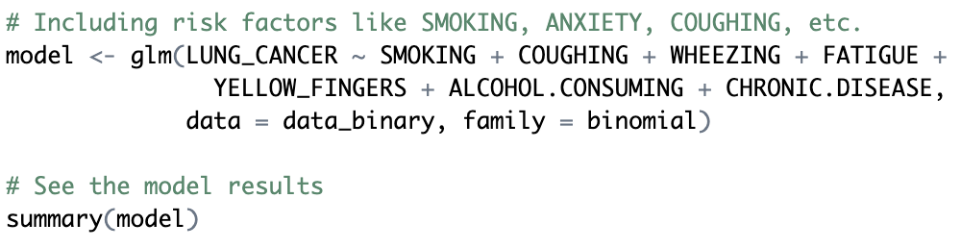
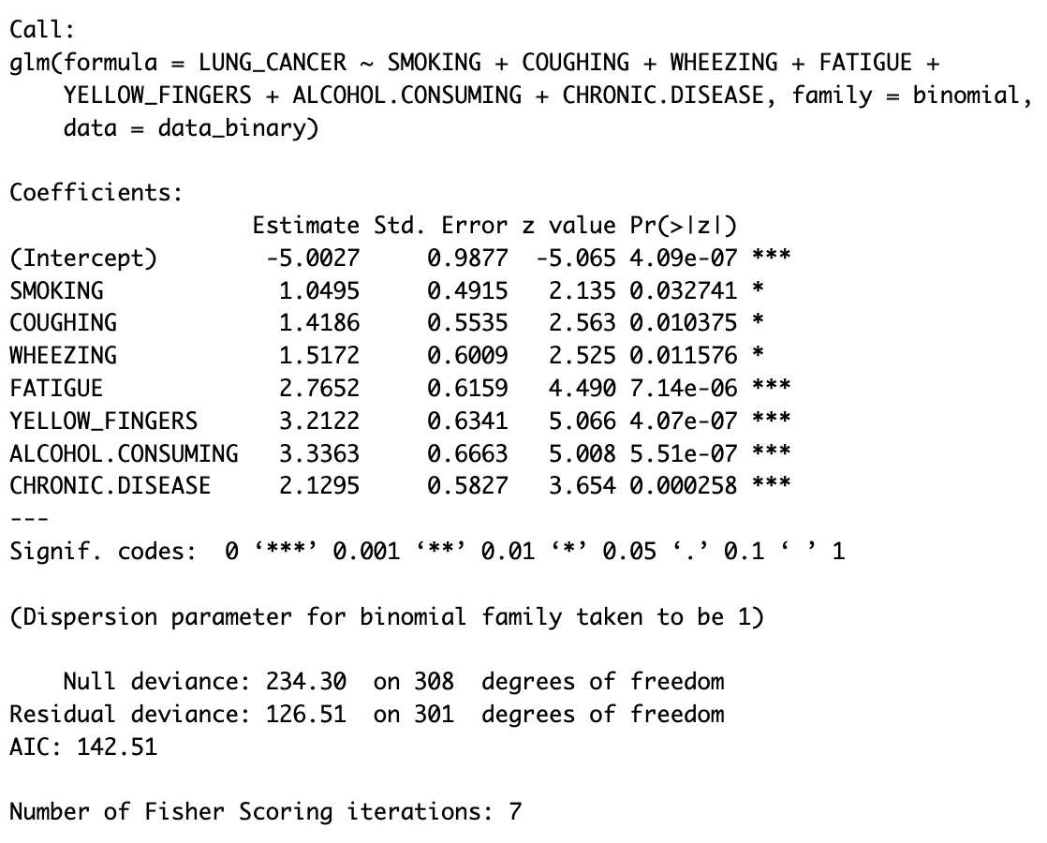
How does the uncertainty in risk factors affect the probability of developing lung cancer?
Code:
Result:
Question 5
Notes:
# All variables included in the model were found to be statistically significant predictors of lung cancer (p < 0.05), indicating strong associations between each factor and the likelihood of developing the disease.
# Fatigue, yellow fingers, alcohol consumption, and chronic disease showed particularly strong effects, suggesting they are critical indicators to monitor for early detection.
# Coughing, wheezing, and smoking also contributed significantly, aligning with known clinical symptoms and behavioral risks.

Slide 14
Thank You!
Questions???

